Slide 1
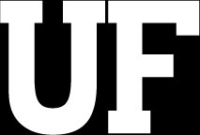
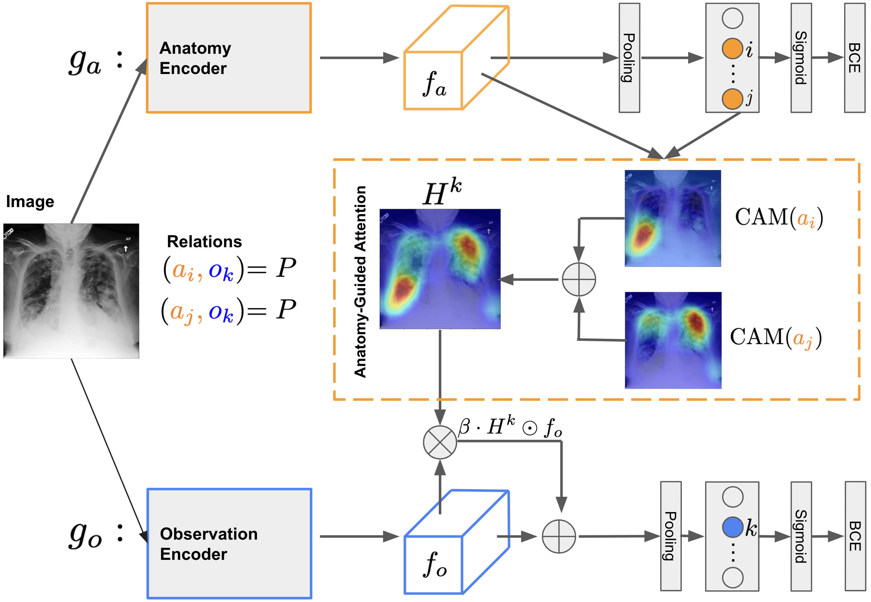
Notes:
Here is the complete architecture of our model. The VAE block aims to infer the latent codes and the GAN block aims to generate to full tuple of factual and counterfactual outcomes. Lets decode it gradually.

